Slide 1



Side-Channel Assisted Malware Classifier with Gradient Descent Correction for Embedded Platforms
Manaar Alam¹, Debdeep Mukhopadhyay¹, Sai Praveen Kadiyala², Siew Kei Lam² and Thambipillai Srikanthan²
¹ Department of Computer Science and Engineering, Indian Institute of Technology Kharagpur
² School of Computer Science and Engineering, Nanyang Technological University Singapore
13th September, 2018, Amsterdam, Netherlands
PROOFS 2018: SECURITY PROOFS FOR EMBEDDED SYSTEMS

Slide 2

Recent News
Image Source: Google Image

Slide 3
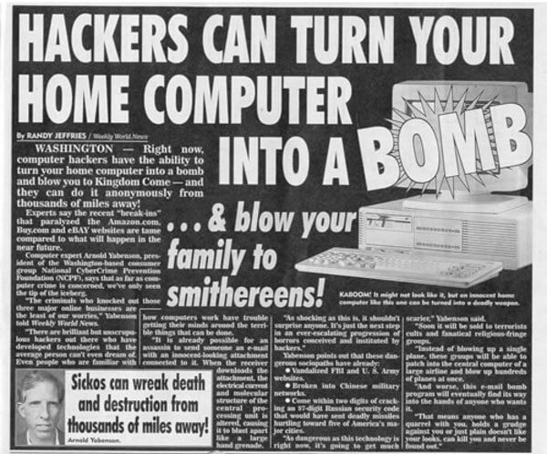
Recent News
Image Source: Google Image

Slide 4
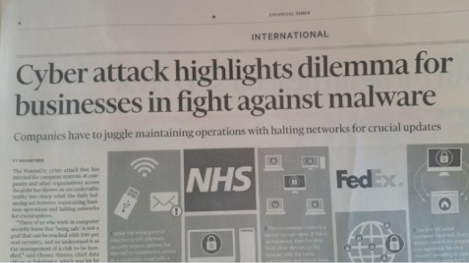
Recent News
Image Source: Google Image

Slide 5

Recent News
Image Source: Google Image

Slide 6
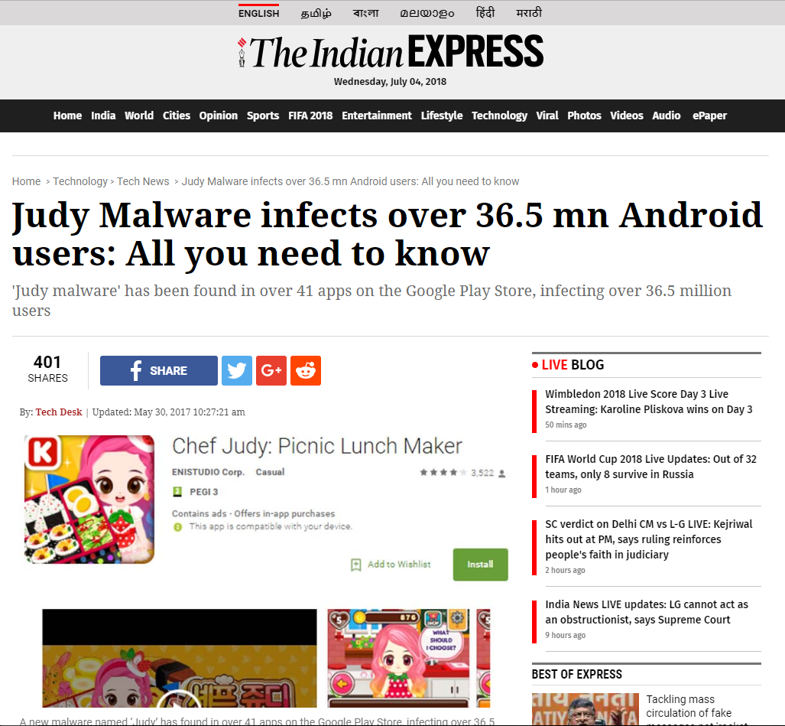
Recent News
Image Source: Google Image

Slide 7

Recent News
Image Source: Google Image

Slide 8

Recent News
Image Source: Google Image

Slide 9

Recent News
Image Source: Google Image

Slide 10

Recent News
Image Source: Google Image

Slide 11

Recent News
Image Source: Google Image

Slide 12
Why their Detection is Important??
Detection Schemes

Slide 13
Why their Detection is Important??
Detection Schemes
Static Analysis

Slide 14
Why their Detection is Important??
Detection Schemes
Static Analysis
Unknown malware could easily bypass this scheme of prevention.

Slide 15
Why their Detection is Important??
Detection Schemes
Static Analysis
Behavioral Analysis
Unknown malware could easily bypass this scheme of prevention.

Slide 16
Why their Detection is Important??
Detection Schemes
Static Analysis
Behavioral Analysis
Unknown malware could easily bypass this scheme of prevention.
Existence of large false positives and false negatives.

Slide 17
Why their Detection is Important??
Detection Schemes
Static Analysis
Behavioral Analysis
Unknown malware could easily bypass this scheme of prevention.
Existence of large false positives and false negatives.
The occurrences of newer varieties of malicious codes and their nature proves that the designing of a generalised detection mechanism is an extremely difficult problem.

Slide 18
Observing System Behavior using HPC

Slide 19
Observing System Behavior using HPC
Hardware Performance Counters
Set of special purpose registers, present in most of the microprocessor's Performance Monitoring Unit (PMU).
Store hardware and software events related to the execution of a program, such as cache misses, retired instructions, retired branch instructions, etc.
Type and number of hardware events vary across different Instruction Set Architectures (ISA).
Various open-source tools can measure this HPC values: perf tools, PAPI, OProfile, Valgrind and many more.

Slide 20
Observing System Behavior using HPC
Linux perf tool
Perf is a profiler tool for Linux 2.6.31+ based systems that presents a simple command line interface to collect and analyze performance counter statistics.
A user can observe the performance counters associated with a system with some time interval, thereby giving the benefit of observing the system behavior continuously in a succession of time.

Slide 21
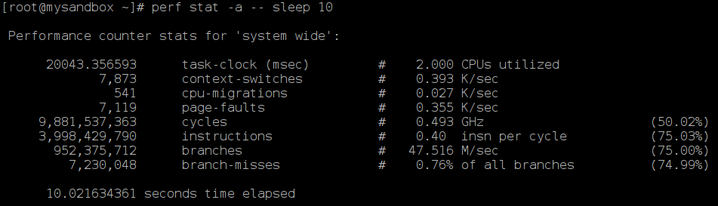
Observing System Behavior using HPC
Linux perf tool
Perf is a profiler tool for Linux 2.6.31+ based systems that presents a simple command line interface to collect and analyze performance counter statistics.
A user can observe the performance counters associated with a system with some time interval, thereby giving the benefit of observing the system behavior continuously in a succession of time.
perf stat -e <event_name> -I <time_interval> <executable_name>

Slide 22
Observing System Behavior using HPC
Linux perf tool
Perf is a profiler tool for Linux 2.6.31+ based systems that presents a simple command line interface to collect and analyze performance counter statistics.
A user can observe the performance counters associated with a system with some time interval, thereby giving the benefit of observing the system behavior continuously in a succession of time.
Events
perf stat -e <event_name> -I <time_interval> <executable_name>

Slide 23
Observing System Behavior using HPC
Linux perf tool
Perf is a profiler tool for Linux 2.6.31+ based systems that presents a simple command line interface to collect and analyze performance counter statistics.
A user can observe the performance counters associated with a system with some time interval, thereby giving the benefit of observing the system behavior continuously in a succession of time.
Values
Events
perf stat -e <event_name> -I <time_interval> <executable_name>

Slide 24
Recent Efforts in Detecting Malwares using HPC
S. Das, Y. Liu, W. Zhang, and M. Chandramohan, “Semantics-based online malware detection: towards efficient real-time protection against malware,” IEEE transactions on information forensics and security, vol. 11, no. 2, pp. 289–302, 2016.
X. Wang and R. Karri, “Reusing hardware performance counters to detect and identify kernel control-flow modifying rootkits,” IEEE Transactions on Computer-Aided Design of Integrated Circuits and Systems, vol. 35, no. 3, pp. 485–498, 2016.
M. Ozsoy, K. N. Khasawneh, C. Donovick, I. Gorelik, N. Abu-Ghazaleh, and D. Ponomarev, “Hardware-based malware detection using low-level architectural features,” IEEE Transactions on Computers, vol. 65, no. 11, pp. 3332–3344, 2016.

Slide 25
Recent Efforts in Detecting Malwares using HPC
S. Das, Y. Liu, W. Zhang, and M. Chandramohan, “Semantics-based online malware detection: towards efficient real-time protection against malware,” IEEE transactions on information forensics and security, vol. 11, no. 2, pp. 289–302, 2016.
X. Wang and R. Karri, “Reusing hardware performance counters to detect and identify kernel control-flow modifying rootkits,” IEEE Transactions on Computer-Aided Design of Integrated Circuits and Systems, vol. 35, no. 3, pp. 485–498, 2016.
M. Ozsoy, K. N. Khasawneh, C. Donovick, I. Gorelik, N. Abu-Ghazaleh, and D. Ponomarev, “Hardware-based malware detection using low-level architectural features,” IEEE Transactions on Computers, vol. 65, no. 11, pp. 3332–3344, 2016.
All have reasonably high false positive rates.

Slide 26
Recent Efforts in Detecting Malwares using HPC
S. Das, Y. Liu, W. Zhang, and M. Chandramohan, “Semantics-based online malware detection: towards efficient real-time protection against malware,” IEEE transactions on information forensics and security, vol. 11, no. 2, pp. 289–302, 2016.
X. Wang and R. Karri, “Reusing hardware performance counters to detect and identify kernel control-flow modifying rootkits,” IEEE Transactions on Computer-Aided Design of Integrated Circuits and Systems, vol. 35, no. 3, pp. 485–498, 2016.
M. Ozsoy, K. N. Khasawneh, C. Donovick, I. Gorelik, N. Abu-Ghazaleh, and D. Ponomarev, “Hardware-based malware detection using low-level architectural features,” IEEE Transactions on Computers, vol. 65, no. 11, pp. 3332–3344, 2016.
X. Wang, C. Konstantinou, M. Maniatakos, and R. Karri, “Confirm: Detecting firmware modifications in embedded systems using hardware performance counters,” in Computer-Aided Design (ICCAD), 2015 IEEE/ACM International Conference on. IEEE, 2015, pp. 544–551.

Slide 27
Recent Efforts in Detecting Malwares using HPC
S. Das, Y. Liu, W. Zhang, and M. Chandramohan, “Semantics-based online malware detection: towards efficient real-time protection against malware,” IEEE transactions on information forensics and security, vol. 11, no. 2, pp. 289–302, 2016.
X. Wang and R. Karri, “Reusing hardware performance counters to detect and identify kernel control-flow modifying rootkits,” IEEE Transactions on Computer-Aided Design of Integrated Circuits and Systems, vol. 35, no. 3, pp. 485–498, 2016.
M. Ozsoy, K. N. Khasawneh, C. Donovick, I. Gorelik, N. Abu-Ghazaleh, and D. Ponomarev, “Hardware-based malware detection using low-level architectural features,” IEEE Transactions on Computers, vol. 65, no. 11, pp. 3332–3344, 2016.
X. Wang, C. Konstantinou, M. Maniatakos, and R. Karri, “Confirm: Detecting firmware modifications in embedded systems using hardware performance counters,” in Computer-Aided Design (ICCAD), 2015 IEEE/ACM International Conference on. IEEE, 2015, pp. 544–551.
Requires Kernel Level Modification

Slide 28
Recent Efforts in Detecting Malwares using HPC
S. Das, Y. Liu, W. Zhang, and M. Chandramohan, “Semantics-based online malware detection: towards efficient real-time protection against malware,” IEEE transactions on information forensics and security, vol. 11, no. 2, pp. 289–302, 2016.
X. Wang and R. Karri, “Reusing hardware performance counters to detect and identify kernel control-flow modifying rootkits,” IEEE Transactions on Computer-Aided Design of Integrated Circuits and Systems, vol. 35, no. 3, pp. 485–498, 2016.
M. Ozsoy, K. N. Khasawneh, C. Donovick, I. Gorelik, N. Abu-Ghazaleh, and D. Ponomarev, “Hardware-based malware detection using low-level architectural features,” IEEE Transactions on Computers, vol. 65, no. 11, pp. 3332–3344, 2016.
X. Wang, C. Konstantinou, M. Maniatakos, and R. Karri, “Confirm: Detecting firmware modifications in embedded systems using hardware performance counters,” in Computer-Aided Design (ICCAD), 2015 IEEE/ACM International Conference on. IEEE, 2015, pp. 544–551.
S. Das, B. Chen, M. Chandramohan, Y. Liu, and W. Zhang, “Ropsentry: runtime defense against rop attacks using hardware performance counters,” Computers & Security, 2017.

Slide 29
Recent Efforts in Detecting Malwares using HPC
S. Das, Y. Liu, W. Zhang, and M. Chandramohan, “Semantics-based online malware detection: towards efficient real-time protection against malware,” IEEE transactions on information forensics and security, vol. 11, no. 2, pp. 289–302, 2016.
X. Wang and R. Karri, “Reusing hardware performance counters to detect and identify kernel control-flow modifying rootkits,” IEEE Transactions on Computer-Aided Design of Integrated Circuits and Systems, vol. 35, no. 3, pp. 485–498, 2016.
M. Ozsoy, K. N. Khasawneh, C. Donovick, I. Gorelik, N. Abu-Ghazaleh, and D. Ponomarev, “Hardware-based malware detection using low-level architectural features,” IEEE Transactions on Computers, vol. 65, no. 11, pp. 3332–3344, 2016.
X. Wang, C. Konstantinou, M. Maniatakos, and R. Karri, “Confirm: Detecting firmware modifications in embedded systems using hardware performance counters,” in Computer-Aided Design (ICCAD), 2015 IEEE/ACM International Conference on. IEEE, 2015, pp. 544–551.
S. Das, B. Chen, M. Chandramohan, Y. Liu, and W. Zhang, “Ropsentry: runtime defense against rop attacks using hardware performance counters,” Computers & Security, 2017.
Specific to Fixed type of Malwares

Slide 30
Focus on Embedded Systems
Difficulty
Often these platforms are resource constrained and runs very simple embedded Linux.
Complex detection mechanism with sophisticated libraries may not work on most of the system.
Detection frameworks with large storage requirement, computational power and kernel modification are not practical in such scenarios.

Slide 31
Focus on Embedded Systems
Difficulty
Often these platforms are resource constrained and runs very simple embedded Linux.
Complex detection mechanism with sophisticated libraries may not work on most of the system.
Detection frameworks with large storage requirement, computational power and kernel modification are not practical in such scenarios.
Advantage
The characterization of benign reference programs for a general purpose Linux environment is trickier due to a large number of possible benign applications.
We can safely assume that in most of the Embedded System, the type of benign applications are limited. A basic music system will only support .mp3 applications.

Slide 32
Contribution
We formalize a concrete “distance” based light-weight side-channel assisted methodology for malware classification on an embedded platform.
As opposed to other approaches, this work first proposes a [0, 1]-based distance metric to determine the amount of “malwareness” of an executable.

Slide 33
Contribution
We formalize a concrete “distance” based light-weight side-channel assisted methodology for malware classification on an embedded platform.
As opposed to other approaches, this work first proposes a [0, 1]-based distance metric to determine the amount of “malwareness” of an executable.
We considered relative sensitivity of both System-calls and Hardware Performance Counters to construct the feature for the malware classifier.
This gives the advantage of both System-call based and HPC based approach.

Slide 34
Contribution
We formalize a concrete “distance” based light-weight side-channel assisted methodology for malware classification on an embedded platform.
As opposed to other approaches, this work first proposes a [0, 1]-based distance metric to determine the amount of “malwareness” of an executable.
We considered relative sensitivity of both System-calls and Hardware Performance Counters to construct the feature for the malware classifier.
This gives the advantage of both System-call based and HPC based approach.
We present a gradient descent based optimization technique to improve the relative sensitivity of the features to obtain significantly better classification accuracy for our test examples.

Slide 35
Basic Idea of the “Distance” Metric
We present a scheme for embedded platforms which aim to support a restricted set of benign programs, or benign reference points.
Benign Reference Points

Slide 36
Basic Idea of the “Distance” Metric
We present a scheme for embedded platforms which aim to support a restricted set of benign programs, or benign reference points.
We formalized a [0, 1] distance metric 𝜆 to quantify the amount of “malwareness” of an executable in comparison to the benign reference points.
Benign Reference Points
𝜆

Slide 37
Basic Idea of the “Distance” Metric
We present a scheme for embedded platforms which aim to support a restricted set of benign programs, or benign reference points.
We formalized a [0, 1] distance metric 𝜆 to quantify the amount of “malwareness” of an executable in comparison to the benign reference points.
The basic notion is that for an unknown Program Under Test (PUT), if its distance from the set of the benign reference point is higher than some threshold value, the PUT is termed as a malware application, whereas PUT having distance lower than the threshold is termed as a benign application.
Benign Reference Points
𝜆

Slide 38
“Features” for the Detection Methodology
System Call based malware detection method may lead to lower false positives but higher false negatives due to newer varieties of malwares.
Behavior based malware detection methods in form of monitoring HPC events results in higher false positives due to the sensitiveness of the events to system noise.

Slide 39
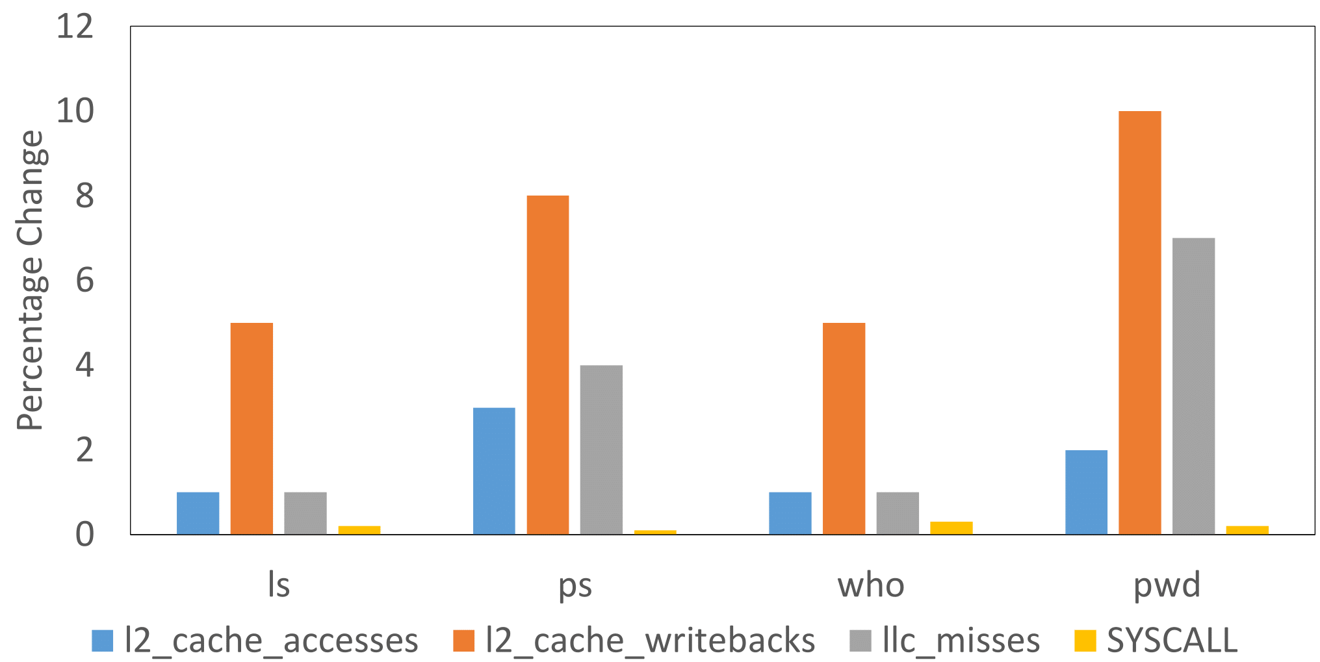
“Features” for the Detection Methodology
System Call based malware detection method may lead to lower false positives but higher false negatives due to newer varieties of malwares.
Behavior based malware detection methods in form of monitoring HPC events results in higher false positives due to the sensitiveness of the events to system noise.
Changes before and after the suturesu rootkit execution

Slide 40
“Features” for the Detection Methodology
System Call based malware detection method may lead to lower false positives but higher false negatives due to newer varieties of malwares.
Behavior based malware detection methods in form of monitoring HPC events results in higher false positives due to the sensitiveness of the events to system noise.
In order to estimate the distance metric, we take into consideration a combination of high-level system calls and HPCs which is much more efficient than relying only on systems calls or only on HPCs.
Changes before and after the suturesu rootkit execution

Slide 41

“Features” for the Detection Methodology
System Call based malware detection method may lead to lower false positives but higher false negatives due to newer varieties of malwares.
Behavior based malware detection methods in form of monitoring HPC events results in higher false positives due to the sensitiveness of the events to system noise.
In order to estimate the distance metric, we take into consideration a combination of high-level system calls and HPCs which is much more efficient than relying only on systems calls or only on HPCs.
Changes before and after the suturesu rootkit execution
Feature $=$ (HPC event, High-Level System Call)

Slide 42

“Features” for the Detection Methodology
System Call based malware detection method may lead to lower false positives but higher false negatives due to newer varieties of malwares.
Behavior based malware detection methods in form of monitoring HPC events results in higher false positives due to the sensitiveness of the events to system noise.
In order to estimate the distance metric, we take into consideration a combination of high-level system calls and HPCs which is much more efficient than relying only on systems calls or only on HPCs.
Changes before and after the suturesu rootkit execution
Feature $=$ (HPC event, High-Level System Call)
Monitor HPC Events for High-Level System Calls running Unknown Executable in the background

Slide 43




Feature Distributions
Indicator Programs (High-Level System Calls)
$$r_{1}$$
$$r_{2}$$
$$r_{3}$$
$$r_{p}$$

Slide 44




Feature Distributions
Indicator Programs (High-Level System Calls)
Observers (HPC Events)
$$r_{1}$$
$$r_{2}$$
$$r_{3}$$
$$r_{p}$$
$$h_{1}$$
$$h_{2}$$
$$h_{3}$$
$$h_{q}$$

Slide 45
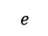
Feature Distributions
Indicator Programs (High-Level System Calls)
Observers (HPC Events)
$$r_{1}$$
$$r_{2}$$
$$r_{3}$$
$$r_{p}$$
$$h_{1}$$
$$h_{2}$$
$$h_{3}$$
$$h_{q}$$
Unknown
Executable
$$e$$

Slide 46
Feature Distributions
Indicator Programs (High-Level System Calls)
Observers (HPC Events)
$$r_{1}$$
$$r_{2}$$
$$r_{3}$$
$$r_{p}$$
$$h_{1}$$
$$h_{2}$$
$$h_{3}$$
$$h_{q}$$
Unknown
Executable
$$e$$

Slide 47
Feature Distributions
Indicator Programs (High-Level System Calls)
Observers (HPC Events)
$$r_{1}$$
$$r_{2}$$
$$r_{3}$$
$$r_{p}$$
$$h_{1}$$
$$h_{2}$$
$$h_{3}$$
$$h_{q}$$
Unknown
Executable
$$e$$

Slide 48
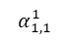
Feature Distributions
Indicator Programs (High-Level System Calls)
Observers (HPC Events)
$$r_{1}$$
$$r_{2}$$
$$r_{3}$$
$$r_{p}$$
$$h_{1}$$
$$h_{2}$$
$$h_{3}$$
$$h_{q}$$
Unknown
Executable
$$e$$
$$α_{1,1}^{1}$$

Slide 49
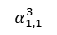
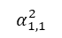
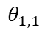
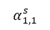
Feature Distributions
Indicator Programs (High-Level System Calls)
Observers (HPC Events)
$$r_{1}$$
$$r_{2}$$
$$r_{3}$$
$$r_{p}$$
$$h_{1}$$
$$h_{2}$$
$$h_{3}$$
$$h_{q}$$
Unknown
Executable
$$e$$
$$α_{1,1}^{1}$$
$$α_{1,1}^{2}$$
$$α_{1,1}^{3}$$
$$α_{1,1}^{s}$$
$$θ_{1,1}$$

Slide 50
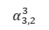
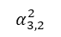
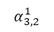
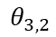
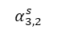
Feature Distributions
Indicator Programs (High-Level System Calls)
Observers (HPC Events)
$$r_{1}$$
$$r_{2}$$
$$r_{3}$$
$$r_{p}$$
$$h_{1}$$
$$h_{2}$$
$$h_{3}$$
$$h_{q}$$
Unknown
Executable
$$e$$
$$α_{3,2}^{1}$$
$$α_{3,2}^{2}$$
$$α_{3,2}^{3}$$
$$α_{3,2}^{s}$$
$$θ_{3,2}$$

Slide 51
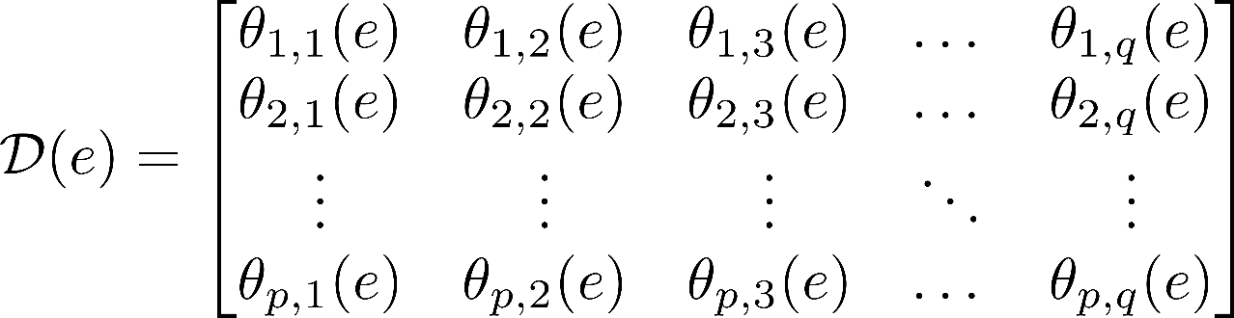
Feature Distributions
Indicator Programs (High-Level System Calls)
Observers (HPC Events)
$$r_{1}$$
$$r_{2}$$
$$r_{3}$$
$$r_{p}$$
$$h_{1}$$
$$h_{2}$$
$$h_{3}$$
$$h_{q}$$
Unknown
Executable
$$e$$
Feature Distribution Matrix

Slide 52
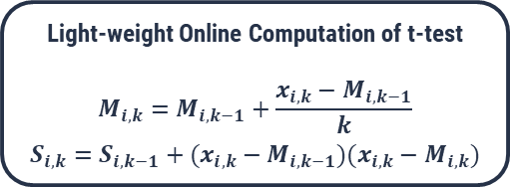
Hypothesis Testing to Identify Effective Features
Light-weight Online Computation of t-test
$$M_{i,k}=M_{i,k−1}+\frac{x_{i,k}−M_{i,k−1}}{k}$$
$$S_{i,k}=S_{i,k−1}+(x_{i,k}−M_{i,k−1})(x_{i,k}−M_{i,k})$$

Slide 53
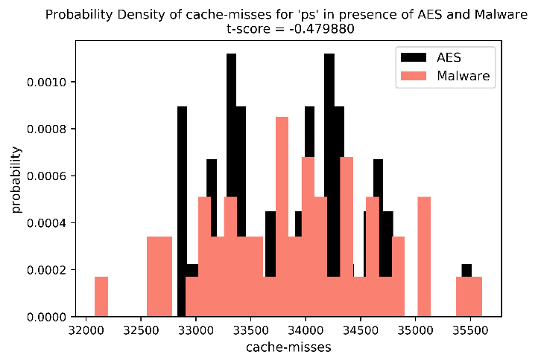
Hypothesis Testing to Identify Effective Features
A feature may be insensitive. It may not be able to distinguish a malware from the benign applications.
(ps, cache-misses)
Light-weight Online Computation of t-test
$$M_{i,k}=M_{i,k−1}+\frac{x_{i,k}−M_{i,k−1}}{k}$$
$$S_{i,k}=S_{i,k−1}+(x_{i,k}−M_{i,k−1})(x_{i,k}−M_{i,k})$$

Slide 54
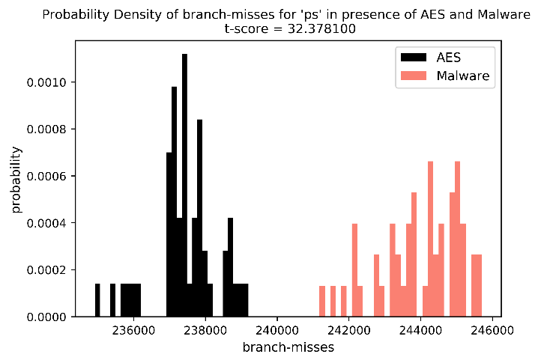
Hypothesis Testing to Identify Effective Features
A feature may be insensitive. It may not be able to distinguish a malware from the benign applications.
Some other features may be sensitive enough to perform the task.
(ps, cache-misses)
(ps, branch-misses)
Light-weight Online Computation of t-test
$$M_{i,k}=M_{i,k−1}+\frac{x_{i,k}−M_{i,k−1}}{k}$$
$$S_{i,k}=S_{i,k−1}+(x_{i,k}−M_{i,k−1})(x_{i,k}−M_{i,k})$$

Slide 55
Hypothesis Testing to Identify Effective Features
A feature may be insensitive. It may not be able to distinguish a malware from the benign applications.
Some other features may be sensitive enough to perform the task.
We do not discard the insensitive features, rather assign a suitable sensitivity value.
(ps, cache-misses)
(ps, branch-misses)
Light-weight Online Computation of t-test
$$M_{i,k}=M_{i,k−1}+\frac{x_{i,k}−M_{i,k−1}}{k}$$
$$S_{i,k}=S_{i,k−1}+(x_{i,k}−M_{i,k−1})(x_{i,k}−M_{i,k})$$

Slide 56
Assigning Sensitivity Value to each Feature
Known Malware Programs
Known Benign Programs

Slide 57
Assigning Sensitivity Value to each Feature
Known Malware Programs
Known Benign Programs

Slide 58
Assigning Sensitivity Value to each Feature
Known Malware Programs
Known Benign Programs

Slide 59






Assigning Sensitivity Value to each Feature
Observers (HPC Events)
Known Malware Programs
$$h_{1}$$
$$h_{2}$$
$$h_{3}$$
$$h_{q}$$
$$r_{1}$$
$$r_{2}$$
Indicator Programs (High-Level System Calls)
$$r_{3}$$
Known Benign Programs
$$r_{p}$$

Slide 60
Assigning Sensitivity Value to each Feature
Observers (HPC Events)
Known Malware Programs
$$h_{1}$$
$$h_{2}$$
$$h_{3}$$
$$h_{q}$$
$$r_{1}$$
$$r_{2}$$
Indicator Programs (High-Level System Calls)
$$r_{3}$$
Known Benign Programs
$$r_{p}$$

Slide 61
Assigning Sensitivity Value to each Feature
Observers (HPC Events)
Known Malware Programs
$$h_{1}$$
$$h_{2}$$
$$h_{3}$$
$$h_{q}$$
$$r_{1}$$
+1
$$r_{2}$$
Indicator Programs (High-Level System Calls)
$$r_{3}$$
Known Benign Programs
$$r_{p}$$

Slide 62
Assigning Sensitivity Value to each Feature
Observers (HPC Events)
Known Malware Programs
$$h_{1}$$
$$h_{2}$$
$$h_{3}$$
$$h_{q}$$
$$r_{1}$$
+1
$$r_{2}$$
Indicator Programs (High-Level System Calls)
$$r_{3}$$
Known Benign Programs
$$r_{p}$$

Slide 63
Assigning Sensitivity Value to each Feature
Observers (HPC Events)
Known Malware Programs
$$h_{1}$$
$$h_{2}$$
$$h_{3}$$
$$h_{q}$$
$$r_{1}$$
+1
$$r_{2}$$
Indicator Programs (High-Level System Calls)
$$r_{3}$$
+0
Known Benign Programs
$$r_{p}$$

Slide 64
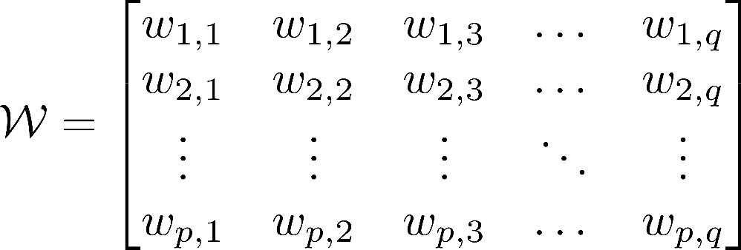
Assigning Sensitivity Value to each Feature
Known Malware Programs
Feature Sensitivity Matrix (After Normalization)
Known Benign Programs

Slide 65
Formalization of Distance Metric (Online)
Known Benign Programs
Unknown
Executable
?

Slide 66
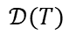
Formalization of Distance Metric (Online)
Known Benign Programs
Unknown
Executable
?
$$𝒟(T)$$
Calculate

Slide 67
Formalization of Distance Metric (Online)
Known Benign Programs
Unknown
Executable
?
$$𝒟(T)$$
Calculate

Slide 68
Formalization of Distance Metric (Online)
Observers (HPC Events)
Known Benign Programs
$$h_{1}$$
$$h_{2}$$
$$h_{3}$$
$$h_{q}$$
$$r_{1}$$
$$r_{2}$$
Indicator Programs (High-Level System Calls)
$$r_{3}$$
Unknown
Executable
$$r_{p}$$
?
$$𝒟(T)$$
Calculate

Slide 69
Formalization of Distance Metric (Online)
Observers (HPC Events)
Known Benign Programs
$$h_{1}$$
$$h_{2}$$
$$h_{3}$$
$$h_{q}$$
$$r_{1}$$
$$r_{2}$$
Indicator Programs (High-Level System Calls)
$$r_{3}$$
Unknown
Executable
$$r_{p}$$
?
$$𝒟(T)$$
Calculate

Slide 70
Formalization of Distance Metric (Online)
Observers (HPC Events)
Known Benign Programs
$$h_{1}$$
$$h_{2}$$
$$h_{3}$$
$$h_{q}$$
$$r_{1}$$
+1
$$r_{2}$$
Indicator Programs (High-Level System Calls)
$$r_{3}$$
Unknown
Executable
$$r_{p}$$
?
$$𝒟(T)$$
Calculate

Slide 71
Formalization of Distance Metric (Online)
Observers (HPC Events)
Known Benign Programs
$$h_{1}$$
$$h_{2}$$
$$h_{3}$$
$$h_{q}$$
$$r_{1}$$
+1
$$r_{2}$$
Indicator Programs (High-Level System Calls)
$$r_{3}$$
Unknown
Executable
$$r_{p}$$
?
$$𝒟(T)$$
Calculate

Slide 72
Formalization of Distance Metric (Online)
Observers (HPC Events)
Known Benign Programs
$$h_{1}$$
$$h_{2}$$
$$h_{3}$$
$$h_{q}$$
$$r_{1}$$
+1
$$r_{2}$$
Indicator Programs (High-Level System Calls)
$$r_{3}$$
+0
Unknown
Executable
$$r_{p}$$
?
$$𝒟(T)$$
Calculate

Slide 73
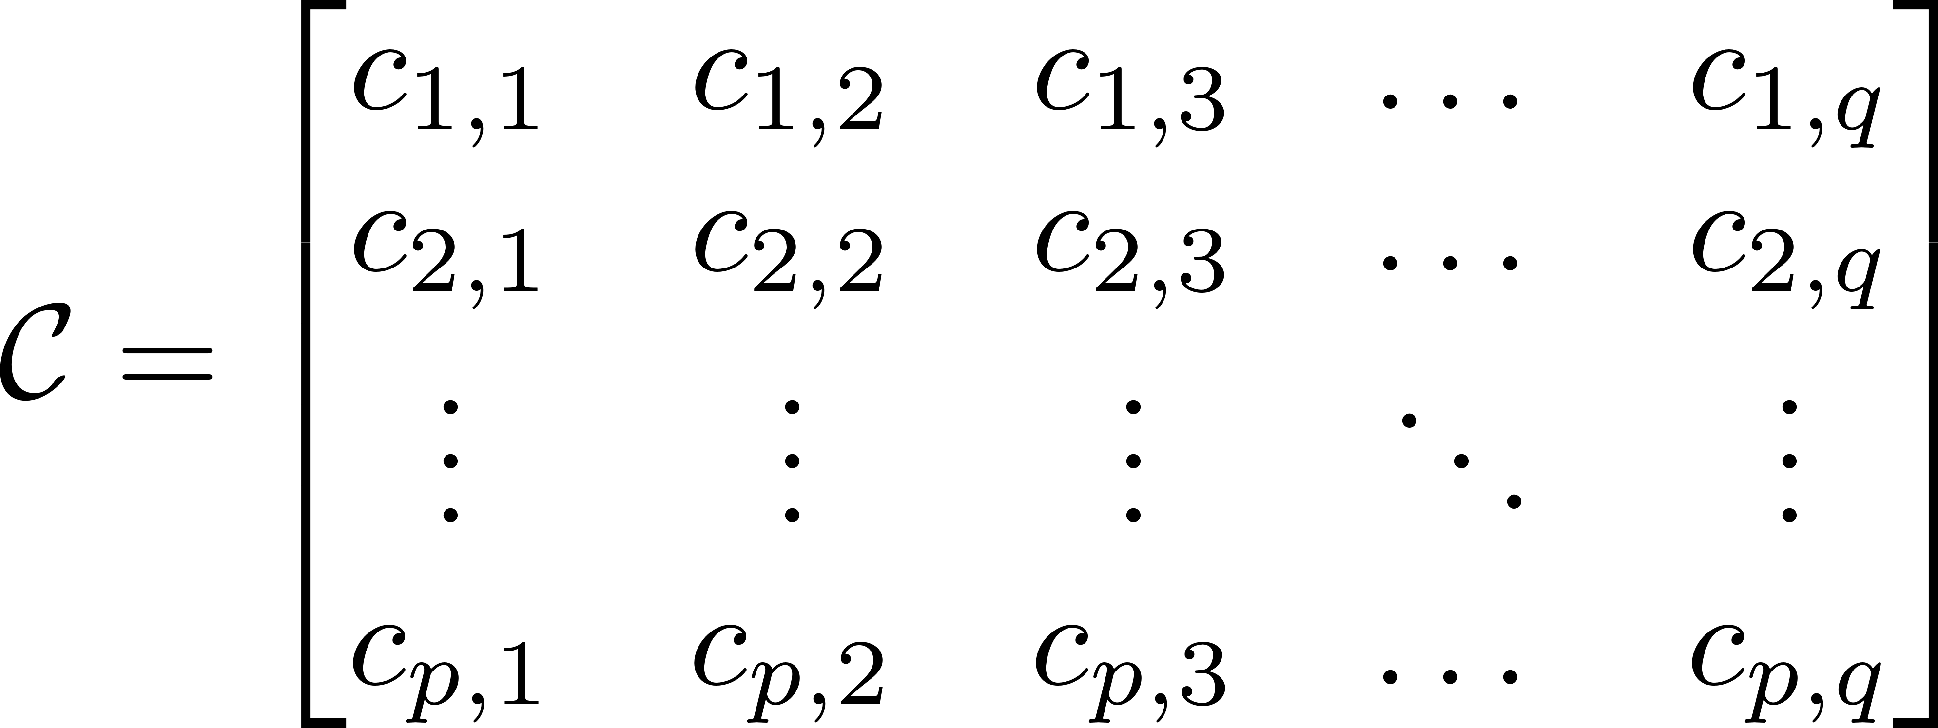
Formalization of Distance Metric (Online)
Known Benign Programs
Count Matrix (After Normalization)
Unknown
Executable
?

Slide 74
Formalization of Distance Metric (Online)
Known Benign Programs
Count Matrix (After Normalization)
Unknown
Executable
?

Slide 75
Formalization of Distance Metric (Online)
Known Benign Programs
Count Matrix (After Normalization)
Computed Online
Unknown
Executable
?

Slide 76
Formalization of Distance Metric (Online)
Known Benign Programs
Count Matrix (After Normalization)
Computed Online
Unknown
Executable
Computed Offline
?

Slide 77

Formalization of Distance Metric (Online)
Known Benign Programs
Count Matrix (After Normalization)
Computed Online
Unknown
Executable
Computed Offline
?
If $λ>threshold$ : The program is a malware, else benign.

Slide 78
Formalization of Distance Metric (Online)
Known Benign Programs
Count Matrix (After Normalization)
Computed Online
Unknown
Executable
Computed Offline
?
If $λ>threshold$ : The program is a malware, else benign.
Calculated using $3σ$ analysis on the $λ$ values of benign reference points

Slide 79
Improving the Metric
We proposed the concept of Sensitivity Matrix to give importance to feature in the offline phase.
Is the matrix optimum?
Is there any other matrix which gives better “separability” between benign and malware programs, such that the decision does not depend on any threshold?

Slide 80
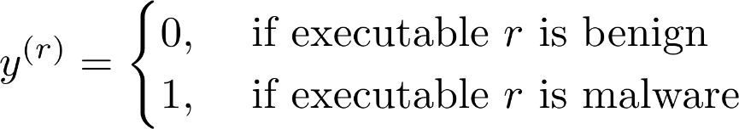
Improving the Metric
We proposed the concept of Sensitivity Matrix to give importance to feature in the offline phase.
Is the matrix optimum?
Is there any other matrix which gives better “separability” between benign and malware programs, such that the decision does not depend on any threshold?
Ideally the label to each executables 𝑟 in the training set should be:

Slide 81
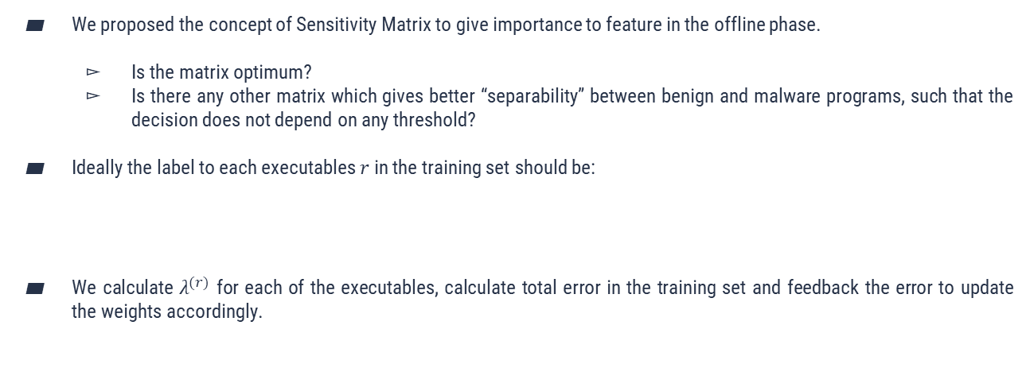
Improving the Metric
We proposed the concept of Sensitivity Matrix to give importance to feature in the offline phase.
Is the matrix optimum?
Is there any other matrix which gives better “separability” between benign and malware programs, such that the decision does not depend on any threshold?
Ideally the label to each executables 𝑟 in the training set should be:
We calculate $λ^{(r)}$ for each of the executables, calculate total error in the training set and feedback the error to update the weights accordingly.

Slide 82
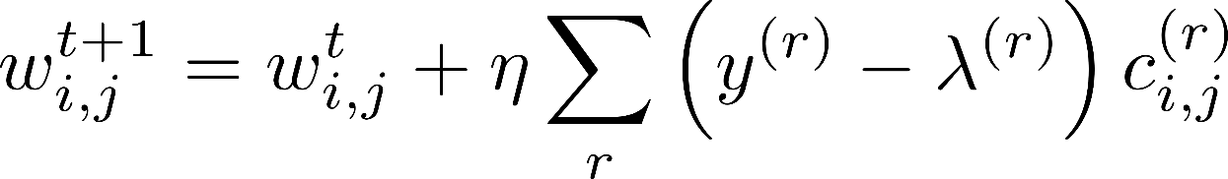
Improving the Metric
We proposed the concept of Sensitivity Matrix to give importance to feature in the offline phase.
Is the matrix optimum?
Is there any other matrix which gives better “separability” between benign and malware programs, such that the decision does not depend on any threshold?
Ideally the label to each executables 𝑟 in the training set should be:
We calculate $λ^{(r)}$ for each of the executables, calculate total error in the training set and feedback the error to update the weights accordingly.
After applying Gradient Descent

Slide 83
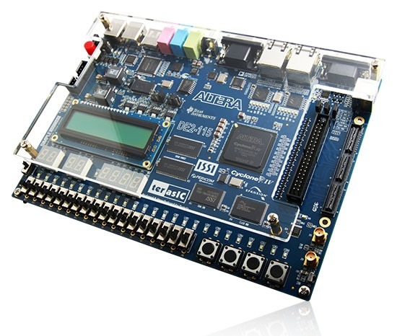
Experimental Setup
We implemented the approach in ALTERA SoCKit VEEK-MT model.
Dual-core ARM Cortex-A9 processor with an Altera 28-nm Cyclone V FPGA.
The Linux based embedded RTOS implemented on this SoCKit has kernel version 3.10.31-ltsi-05172-g28bac3e.
 | Family | Train | Test | Total
Malware | ARM-Malwares | 152 | 10 | 162
Benign | CHStone | 10 | 2 | 12
 | UnixBench | 12 | 4 | 16
 | LMBench | 18 | 4 | 22
Total |  | 192 | 20 | 212

Slide 84
Experimental Setup
We implemented the approach in ALTERA SoCKit VEEK-MT model.
Dual-core ARM Cortex-A9 processor with an Altera 28-nm Cyclone V FPGA.
The Linux based embedded RTOS implemented on this SoCKit has kernel version 3.10.31-ltsi-05172-g28bac3e.
Offensive Computing
 | Family | Train | Test | Total
Malware | ARM-Malwares | 152 | 10 | 162
Benign | CHStone | 10 | 2 | 12
 | UnixBench | 12 | 4 | 16
 | LMBench | 18 | 4 | 22
Total |  | 192 | 20 | 212
Virusshare

Slide 85
Results
Features Selected
Indicator Programs: ls, netstat, ps, who, pwd
Observers: cycles, instructions, cache-references, cache-misses, branches, branch-misses

Slide 86
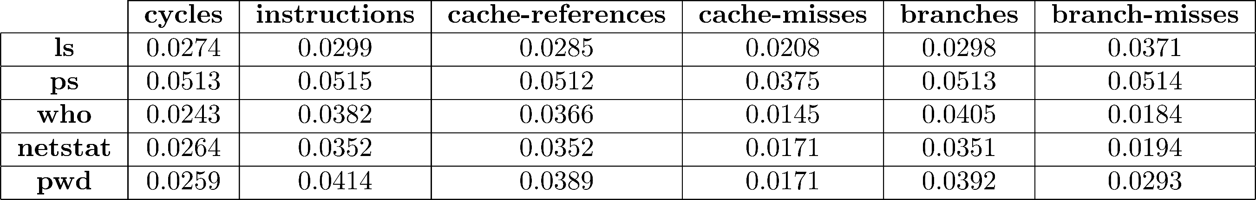
Results
Features Selected
Indicator Programs: ls, netstat, ps, who, pwd
Observers: cycles, instructions, cache-references, cache-misses, branches, branch-misses
Initial Sensitivity Matrix

Slide 87
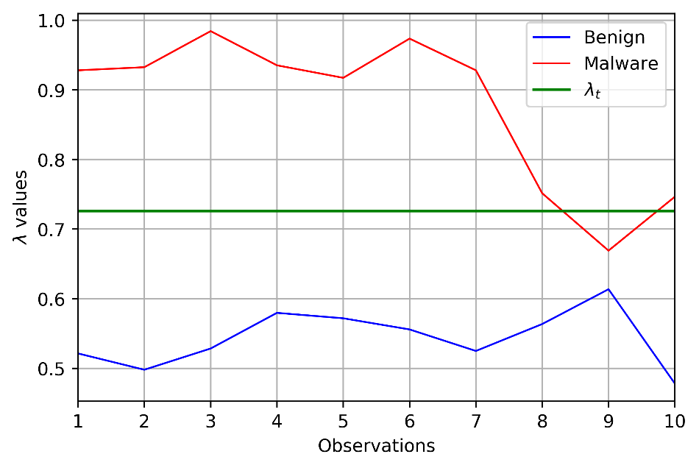
Results
Analyzing Unknown Programs using Initial Sensitivity Matrix

Slide 88
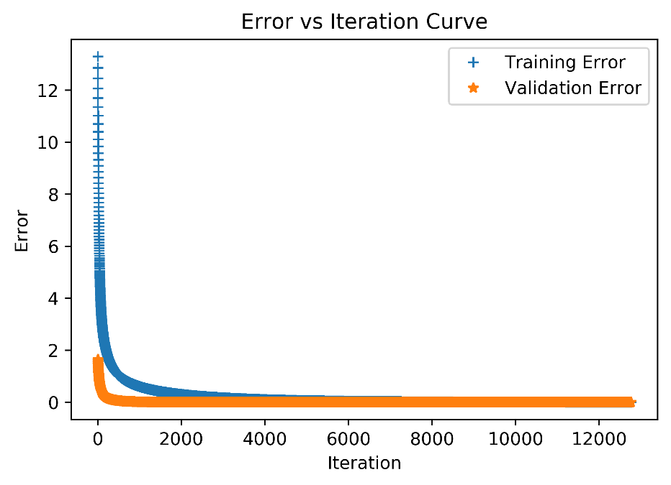
Results
Analyzing Unknown Programs using Initial Sensitivity Matrix
Apply Gradient Descent Correction

Slide 89
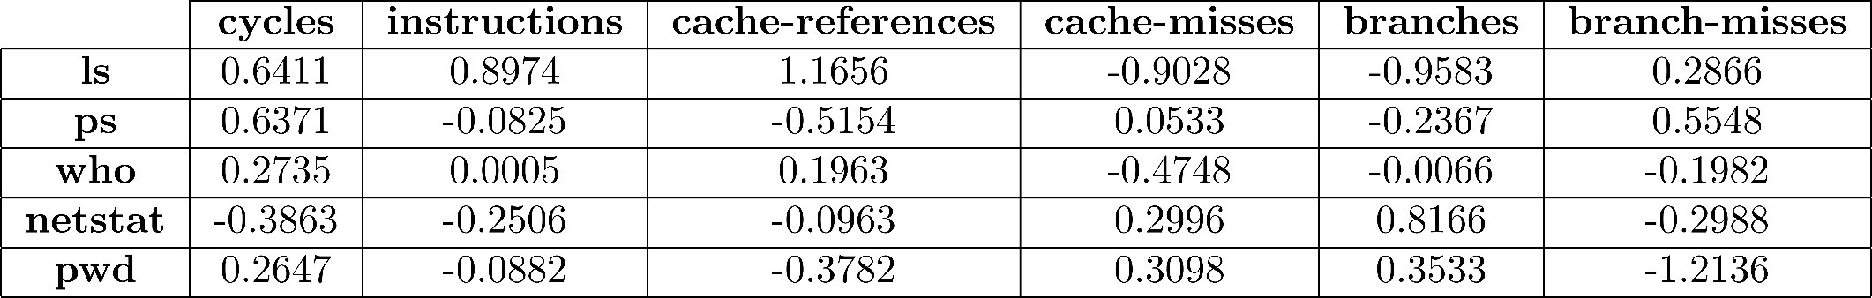
Results
Updated Sensitivity Matrix

Slide 90
Results
Updated Sensitivity Matrix
Analyzing Unknown Programs using Updated Sensitivity Matrix

Slide 91
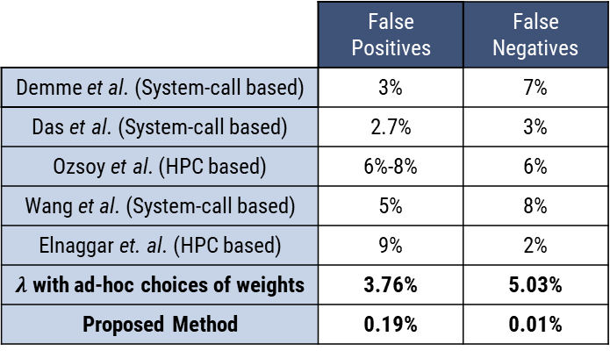
Results
Comparison with State-of-the-Art
 | False Positives | False Negatives
Demme et al. (System-call based) | 3% | 7%
Das et al. (System-call based) | 2.7% | 3%
Ozsoy et al. (HPC based) | 6%-8% | 6%
Wang et al. (System-call based) | 5% | 8%
Elnaggar et. al. (HPC based) | 9% | 2%
$λ$ with ad-hoc choices of weights | 3.76% | 5.03%
Proposed Method | 0.19% | 0.01%

Slide 92
Results
Comparison with State-of-the-Art
Implementation Overhead
 | False Positives | False Negatives
Demme et al. (System-call based) | 3% | 7%
Das et al. (System-call based) | 2.7% | 3%
Ozsoy et al. (HPC based) | 6%-8% | 6%
Wang et al. (System-call based) | 5% | 8%
Elnaggar et. al. (HPC based) | 9% | 2%
$λ$ with ad-hoc choices of weights | 3.76% | 5.03%
Proposed Method | 0.19% | 0.01%
Processor | CPU Utilization (per second) | Memory Utilization (per second)
ARM Cortex-A9 | 16.788% | 0.798%

Slide 93
Results
Comparison with State-of-the-Art
Implementation Overhead
 | False Positives | False Negatives
Demme et al. (System-call based) | 3% | 7%
Das et al. (System-call based) | 2.7% | 3%
Ozsoy et al. (HPC based) | 6%-8% | 6%
Wang et al. (System-call based) | 5% | 8%
Elnaggar et. al. (HPC based) | 9% | 2%
$λ$ with ad-hoc choices of weights | 3.76% | 5.03%
Proposed Method | 0.19% | 0.01%
Processor | CPU Utilization (per second) | Memory Utilization (per second)
ARM Cortex-A9 | 16.788% | 0.798%
Total virtual memory size used by the model to detect a single program under test is around 9MB

Slide 94
Results
Comparison with State-of-the-Art
Implementation Overhead
 | False Positives | False Negatives
Demme et al. (System-call based) | 3% | 7%
Das et al. (System-call based) | 2.7% | 3%
Ozsoy et al. (HPC based) | 6%-8% | 6%
Wang et al. (System-call based) | 5% | 8%
Elnaggar et. al. (HPC based) | 9% | 2%
$λ$ with ad-hoc choices of weights | 3.76% | 5.03%
Proposed Method | 0.19% | 0.01%
Processor | CPU Utilization (per second) | Memory Utilization (per second)
ARM Cortex-A9 | 16.788% | 0.798%
Total virtual memory size used by the model to detect a single program under test is around 9MB
Includes size of all codes, data, and shared libraries

Slide 95
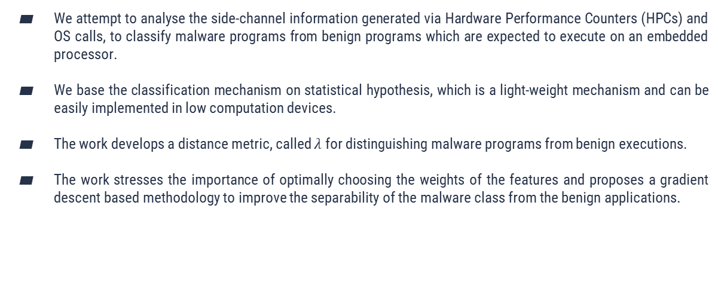
Conclusion
We attempt to analyse the side-channel information generated via Hardware Performance Counters (HPCs) and OS calls, to classify malware programs from benign programs which are expected to execute on an embedded processor.
We base the classification mechanism on statistical hypothesis, which is a light-weight mechanism and can be easily implemented in low computation devices.
The work develops a distance metric, called $λ$ for distinguishing malware programs from benign executions.
The work stresses the importance of optimally choosing the weights of the features and proposes a gradient descent based methodology to improve the separability of the malware class from the benign applications.

Slide 96
Acknowledgement
We would like to acknowledge Haldia Petrochemicals Ltd. and TCG Foundation for partially supporting the research through the grant entitled “Cyber Security Research in CPS”.

Slide 97
THANK YOU FOR YOUR ATTENTION!
Any questions?

